Slide 1
Telangana Electricity Consumption

Slide 2
Introduction
• Need for electricity monitoring in Telangana
• Importance of trend analysis
• Objective: Provide insights to help energy planners

Slide 3
Dataset Source
• Data from TGSPDCL
• CSV files:
- March 2025
- March (2022–2025)
- All months in 2024

Slide 4
Glossary of Terms
• Circle: District
• catdesc: Type of connection
• totservices: Total Connections
• units: Billed units, etc.

Slide 5
Dataset Description
• March 2025: Area & category-wise
• March (2022–2025): Yearly comparison
• 2024 All Months: Monthly/seasonal analysis

Slide 6
EDA Process
• Tools: Pandas, Matplotlib, Seaborn, NumPy
• Steps:
- Data cleaning & grouping
- Visualization
- Trend identification

Slide 7
Consumption Trends (2022–2025)
• Simulated using NumPy linspace
• Bar plot shows steady growth
• Insight: Reflects urbanization and increased demand

Slide 8
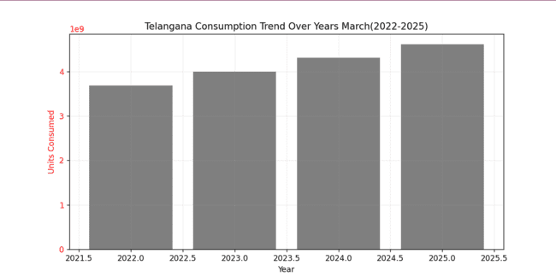
Consumption trend

Slide 9
Top & Bottom Consuming Areas
• Top 6: High-demand zones
• Bottom 6: Underutilized regions
• Combined chart shows disparity

Slide 10
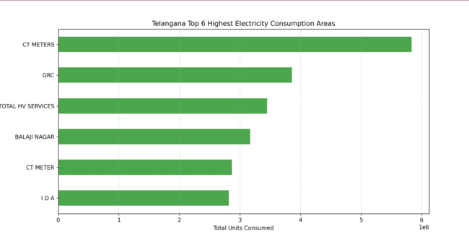
Top 6 Areas

Slide 11
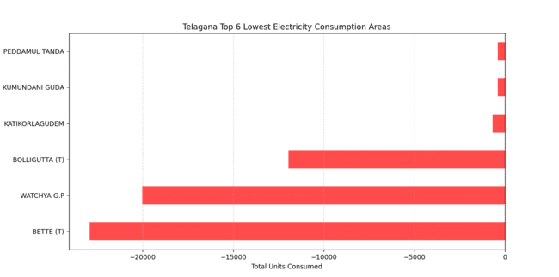
Least 6 areas

Slide 12
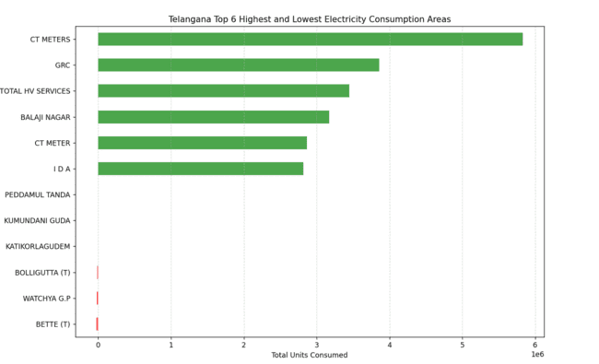
Highest&lowest

Slide 13
Seasonal Variations (2024)
• Grouped months into seasons
• Highest: Summer (May–July)
• Lowest: Winter
• Visualized via Seaborn barplot

Slide 14
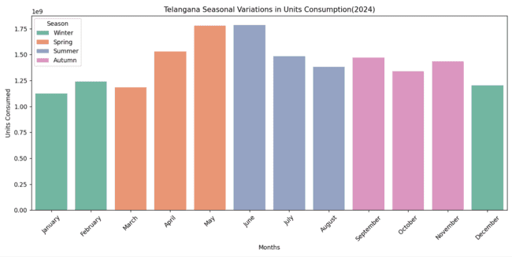
Seasonal variations

Slide 15
Domestic vs. Non-Domestic Usage (2025)
• Classified by keywords
• Result: Domestic > 60% share
• Visual: Pie chart

Slide 16
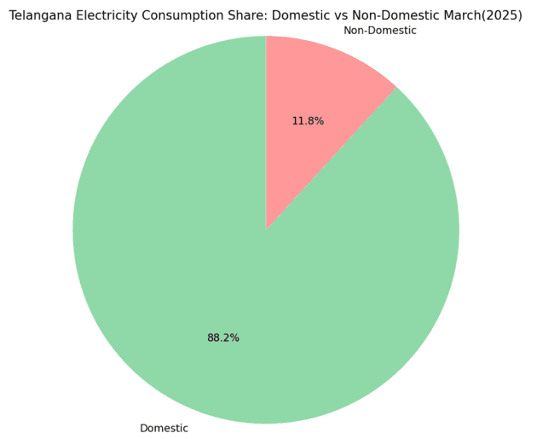
Domastic vs Non-Domastic

Slide 17
Sudden Usage Spikes in 2024
• Month-to-month change > 20% highlighted
• Line chart with red markers
• Helps detect anomalies like heatwaves

Slide 18
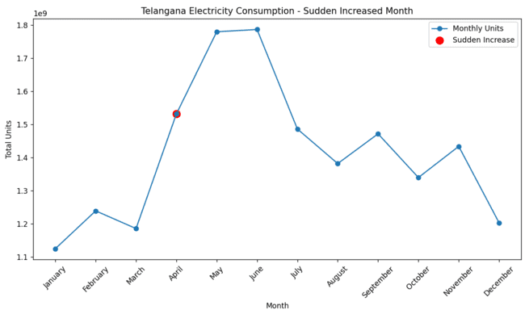
Sudden usage spikes(2024)

Slide 19
References
• Telangana Govt. Data Portal
• pandas.pydata.org
• matplotlib.org
• seaborn.pydata.org
• numpy.org

Slide 20
Thank you

